Slide 1

SALARIES DATA
Project by vidyadhari

Slide 2
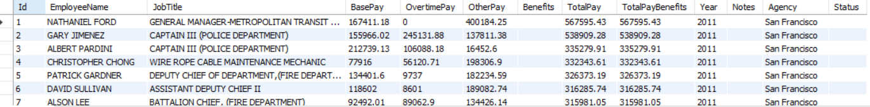
Show all columns and rows in the table.
Select * from salaries;

Slide 3
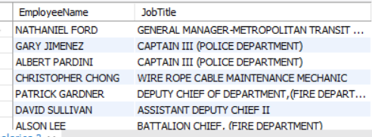
Show only the EmployeeName and JobTitle columns.
select EmployeeName,JobTitle from salaries;

Slide 4

Show the number of employees in the table.
select count(*) from salaries;

Slide 5
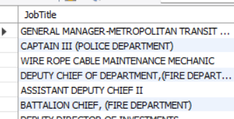
Show the unique job titles in the table.
select distinct JobTitle from salaries;

Slide 6
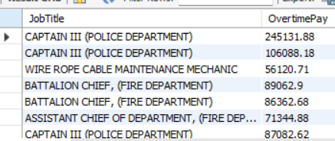
Show the job title and overtime pay for all employees with overtime pay greater than 50000.
select JobTitle,OvertimePay from salaries
where OvertimePay > 50000;

Slide 7

Show the average base pay for all employees.
select AVG(BasePay) as "Avg BasePay" from salaries;

Slide 8
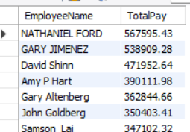
Show the top 10 highest paid employees.
select EmployeeName,TotalPay from salaries
order by TotalPay desc
limit 10;

Slide 9
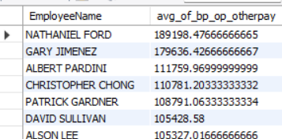
Show the average of BasePay, OvertimePay, and OtherPay for each employee:
select EmployeeName, (BasePay + OvertimePay + OtherPay)/3 as avg_of_bp_op_otherpay from salaries;

Slide 10
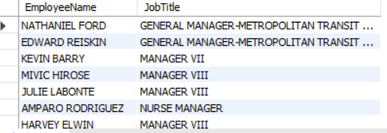
Show all employees who have the word "Manager" in their job title.
select EmployeeName,JobTitle from salaries
where JobTitle LIKE '%Manager%';

Slide 11
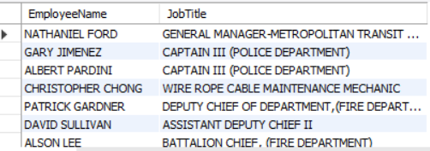
Show all employees with a job title not equal to "Manager".
select EmployeeName,JobTitle from salaries
where JobTitle <>'Manager';

Slide 12
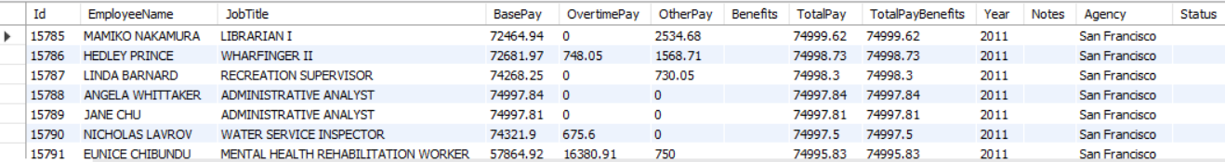
Show all employees with a total pay between 50,000 and 75,000.
select * from salaries
where TotalPay>=50000 and TotalPay <=75000

Slide 13
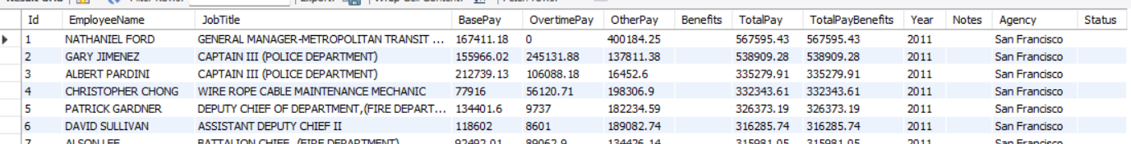
Show all employees with a base pay less than 50,000
-- or a total pay greater than 100,000.
select * from salaries
where BasePay < 50000 or TotalPay > 100000;

Slide 14
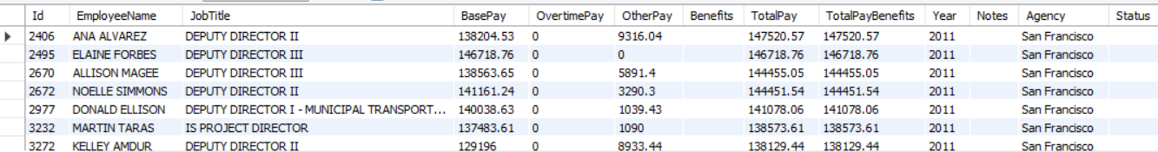
Show all employees with a total pay benefits value
-- between 125,000 and 150,000 and a job title containing the word "Director".
select * from salaries
where TotalPayBenefits between 125000 and 150000
and JobTitle LIKE "%Director%" ;

Slide 15
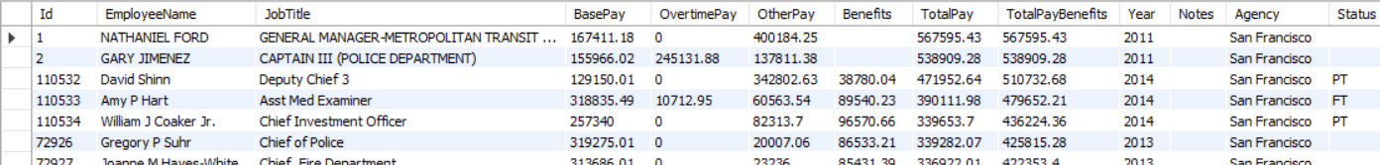
Show all employees ordered by their total pay benefits in descending order.
select * from salaries
order by TotalPayBenefits desc;

Slide 16
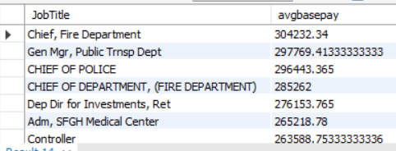
Show all job titles with an average base pay of
-- at least 100,000 and order them by the average base pay in descending order.
select JobTitle, AVG(BasePay) as "avgbasepay" from salaries
group by JobTitle
having avg(BasePay) >=100000
order by avgbasepay desc;

Slide 17
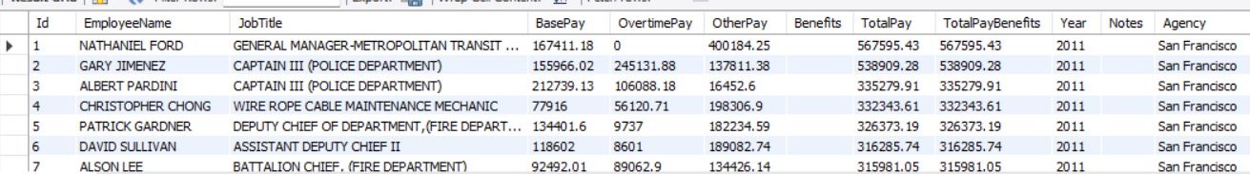
Update the base pay of all employees with
-- the job title containing "Manager" by increasing it by 10%.
update salaries
set BasePay = BasePay * 1.1
where JobTitle Like "%Manager%";
select * from salaries;

